Slide 1
Take a moment to understand the options for MFA at Moraine Park, and determine which meets your needs.
Microsoft Authenticator is an app that installs on your smart phone. This is our recommended method. Once installed, approvals are very quick and easy.
You can also use a cell phone to receive a text message or a phone call to use as an authentication factor. Selecting “text message” will deliver a code to your phone which needs to be entered to complete the authentication process.
Selecting “telephone call” requires the dialed number to be answered to complete the authentication process. We would NOT recommend using “telephone call” as a method on a land line.
If you do not have a smart phone or cell phone, please contact us at AskIT@morainepark.edu and we will provide a process that will work for you.
Click to Continue

Slide 2
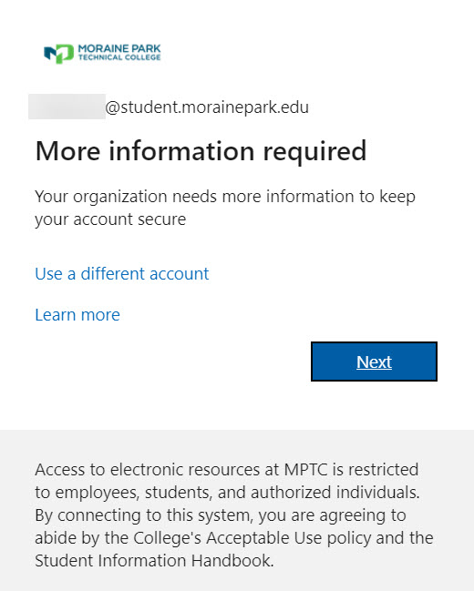
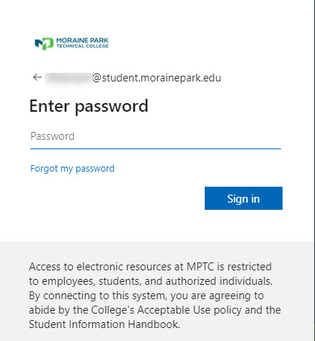
MFA Setup
Go to https://portal.office.com to log into your staff or student email address, select Next
Enter your password, select Sign In
Click to Continue

Slide 3
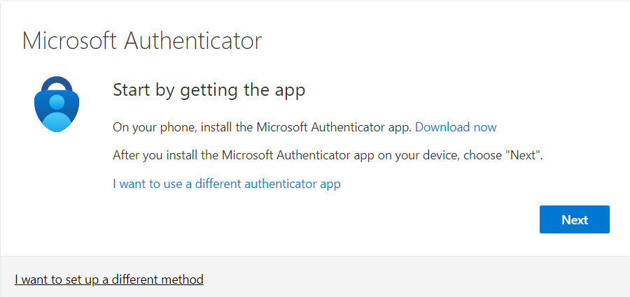
MFA Setup
You will then receive the message below
There are two methods to configure MFA on your account (Microsoft Authenticator App or Phone)
Click which method you would like to set up first:
Microsoft Authenticator
Receive a text message or phone call
Click here when finished

Slide 4
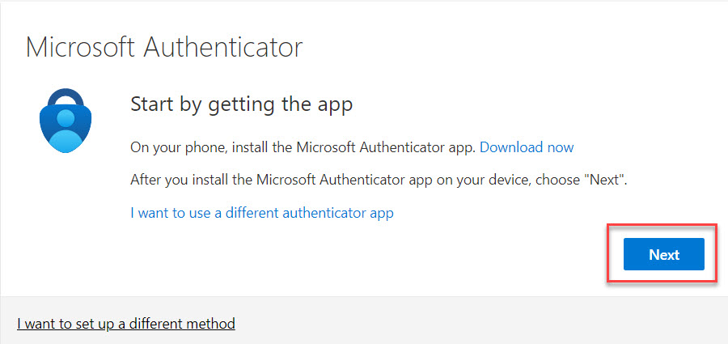
Microsoft Authenticator App
On Your Phone
Use either Play Store (Android) or App Store (Apple)
Search “Microsoft Authenticator”, click to download and Install
Then open the App on your phone….
On Your Computer
….then on your computer select Next
Click thru all prompts on your Computer until you see the QR code
Back to MFA Setup
Click to Continue

Slide 5
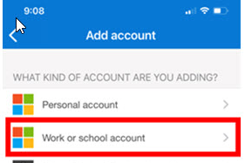
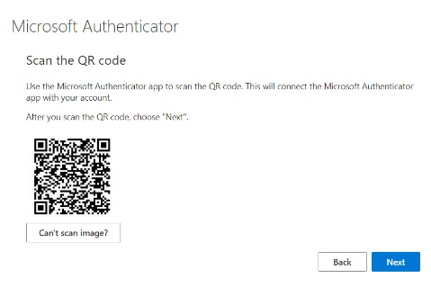
Microsoft Authenticator App
On Your Phone
Click the “+” sign, in the upper right-hand corner of the Authenticator app
Select add a work or school account
On your phone, select “Scan a QR Code”
You will need to enable Authenticator to allow to use your camera at least once
Then scan the code on your computer screen (image below of computer screen)
You will then get a message on your phone that your account was added
Click to Continue

Slide 6
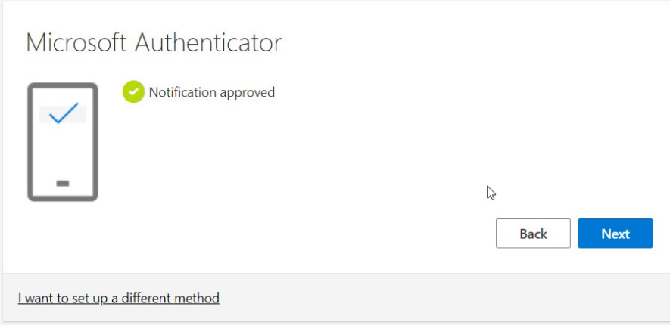
Microsoft authenticator app
On Your Computer
On your computer screen select Next
On Your Phone
Then select “Approve sign-in” on your phone
A test message is sent and then you will need to enter your lock screen pin (This is the pin used to unlock your phone)
On Your Computer
Message on computer screen shows “Notification approved”, select Next on computer screen
Click to Continue

Slide 7
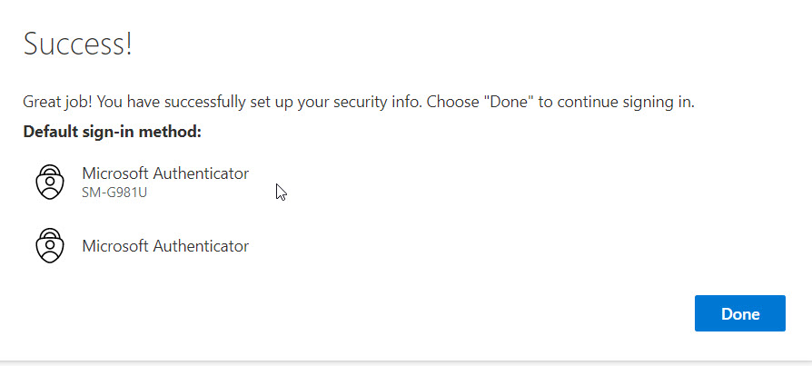
Microsoft Authenticator app
On Your Computer
On your computer screen you will receive a “Success” message, click Done
WARNING
Please note that you will need this phone available whenever you log into approve the log in
RECOMMENDATION
Your phone should be added as a backup authentication method. Click here for those steps

Slide 8
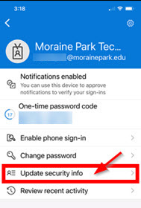
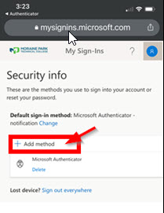
Add phone via authenticator app
From Microsoft Authenticator App
Click on your Account
Click on Update security info
**This will open a browser and may ask you to authenticate into the O365 environment**
Once signed in your will be presented with the Security Info page. This is your MFA security profile. There will be a list of methods which will include your newly added “Microsoft Authenticator” method.
Select Add Method or Add Sign-in Method
Click to Continue

Slide 9
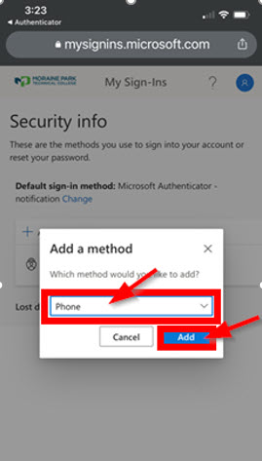
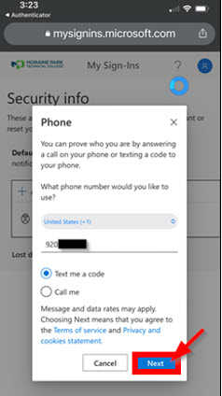
Add phone via authenticator app
A pop-up window will appear
Choose Phone from the drop-down menu and select Add
Enter your 10-digit phone number and select Next
Click to Continue

Slide 10
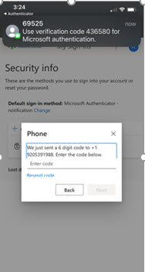
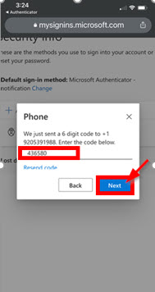
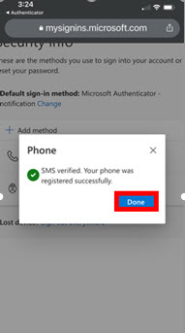
Add phone via authenticator app
You will be sent a 6 digit code via text to confirm the phone number
Enter the code as prompted and select Next
It may take several minutes for you to get this code
Select Done
Click to Continue

Slide 11
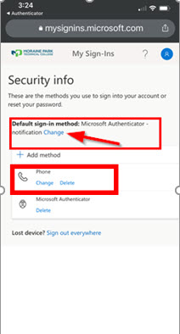
Add phone via authenticator app
Once complete, you will be taken back to the Security Info page
Verify that your phone number has been added to the list
Also verify that Microsoft Authenticator – notification is selected as your “Default sign-in method”
If it is not, select the blue change link and select it from the drop-down menu
Click to Continue

Slide 12
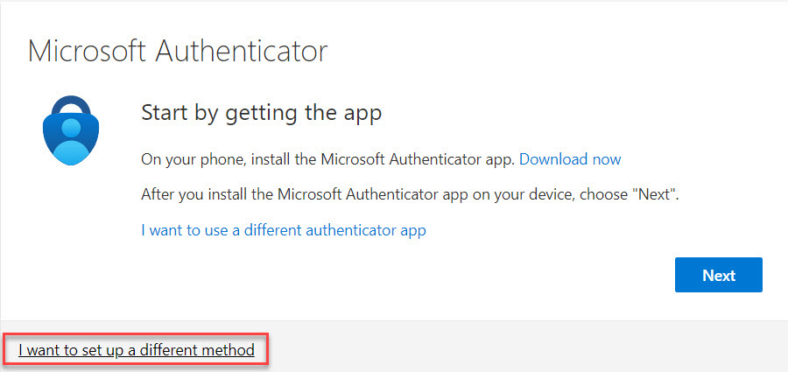
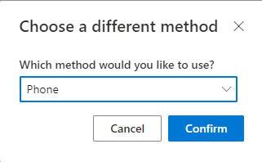
Phone method
Select “I want to set up a different method”
Select “Phone” and “Confirm”, Next
Back to MFA Setup
Click to Continue

Slide 13
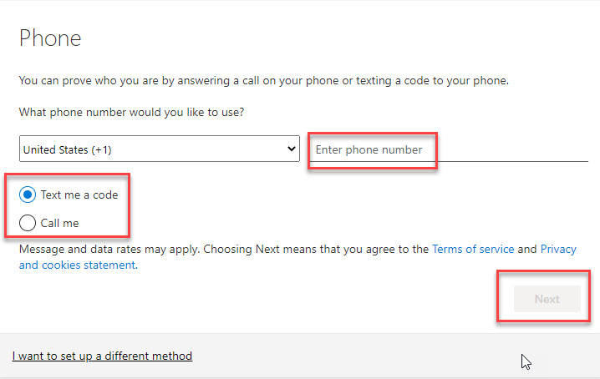
Phone method
Enter your cell phone number, select either “text” or “Call me”, Next
Click to Continue

Slide 14
Phone method
Enter the 6 digit code, Next
Click to Continue

Slide 15
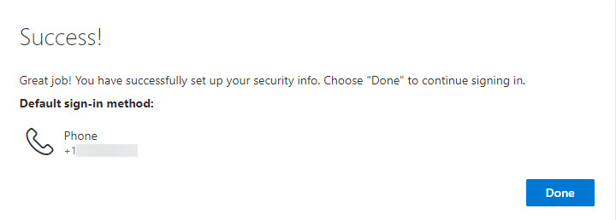
Phone method
You will receive a message “SMS verified. Your phone was registered successfully.”
Select Next
Success!
select Done
WARNING ~ Please note that this phone will need to be available whenever you log in to approve the log in
Click to Continue
Back to MFA Setup

Slide 16
CONGRATULATIONS,
you have set up MFA for your Moraine Park Technical College account
If you have any further questions please contact us at AskIT@morainepark.edu
Click for MFA Options

